Slide 1
Status Report
2015. 11. 18
Nam Jong Woo

Slide 2
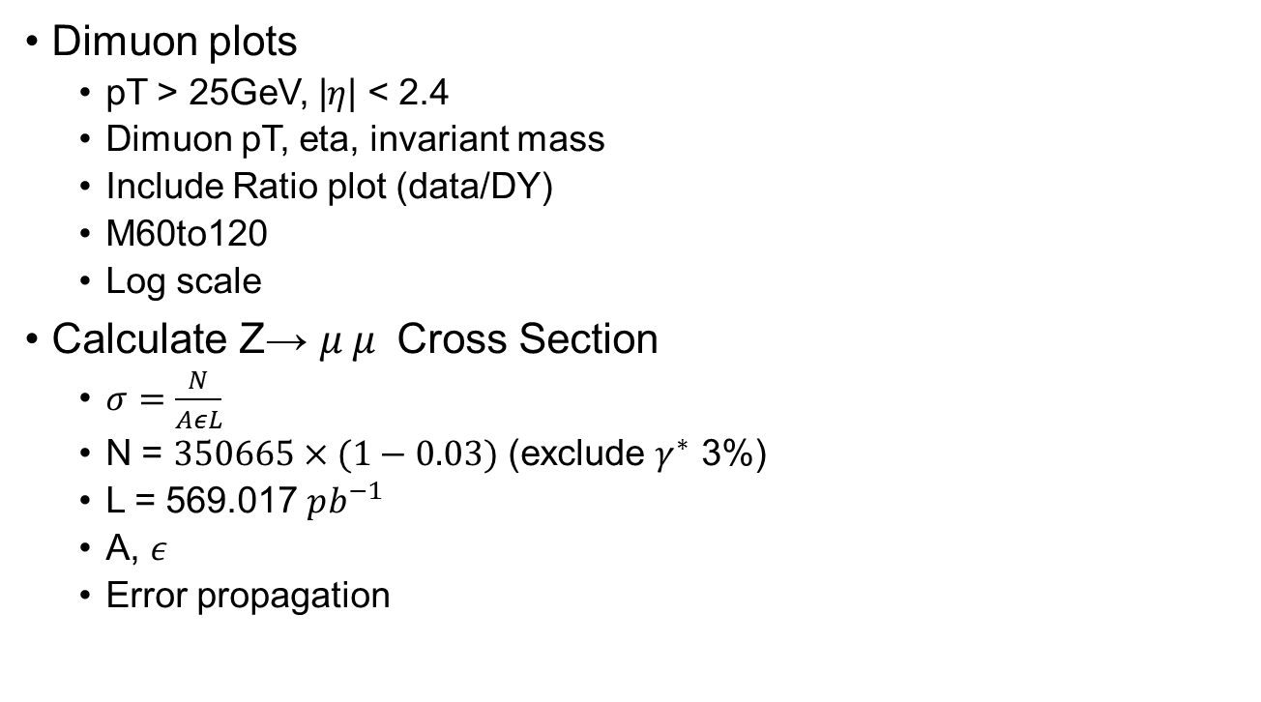
Action Item
Dimuon plots
pT > 25GeV, |$η$| < 2.4
Dimuon pT, eta, invariant mass
Include Ratio plot (data/DY)
M60to120
Log scale
Calculate Z→ $μ^{ }μ^{ }$ Cross Section
$σ=\frac{N}{AεL}$
N = $350665×(1−0.03)$ (exclude $γ^{∗}$ 3%)
L = 569.017 $pb^{−1}$
A, $ε$
Error propagation

Slide 3
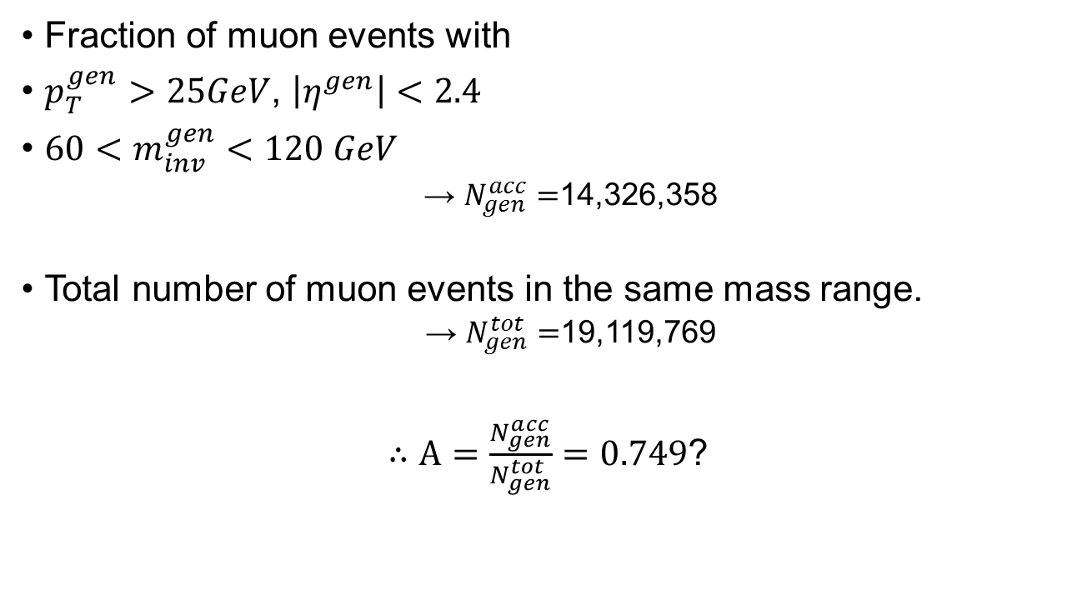
Acceptance
Fraction of muon events with
$p_{T}^{gen}>25GeV$, $\left|η^{gen}\right|<2.4$
$60<m_{inv}^{gen}<120 GeV$
→ $N_{gen}^{acc}=$14,326,358
Total number of muon events in the same mass range.
→ $N_{gen}^{tot}=$19,119,769
$∴A=\frac{N_{gen}^{acc}}{N_{gen}^{tot}}=0.749$?

Slide 4

Efficiency
Fraction of selected events with
${60<m}_{inv}^{reco}<120GeV$
→ $N_{reco}^{sel}=$2,504,640
Divided by $N_{gen}^{acc}$ $=$14,326,358
$∴ε=\frac{N_{reco}^{sel}}{N_{gen}^{acc}}=0.1748$?

Slide 5

Cross Section
$σ=\frac{N}{AεL}$
N = $350,665×(1−0.03)$ (exclude $γ^{∗}$ 3%)
L = 569.017 $pb^{−1}$
A = $0.749$
$ε$ = $0.17$5
$∴σ(Z→μμ)=4560.569 pb$ ?

Slide 6
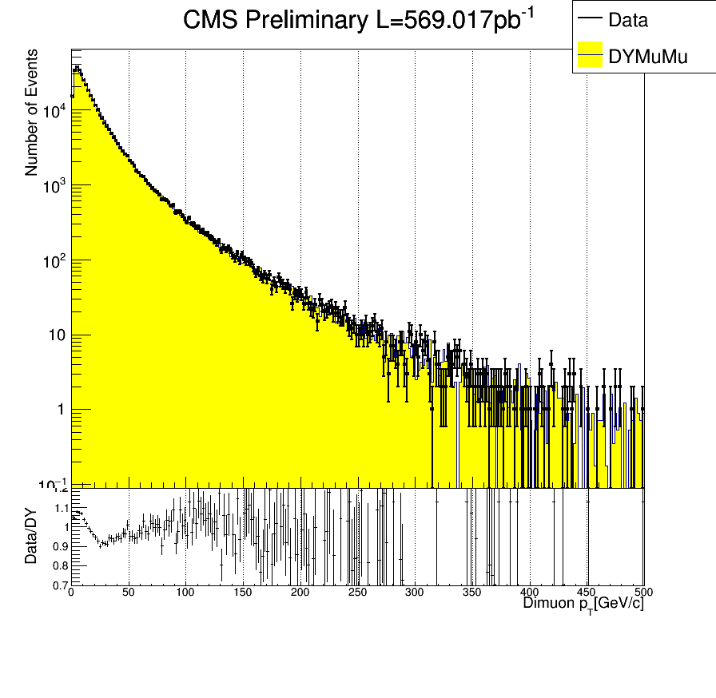
Dimuon pT

Slide 7
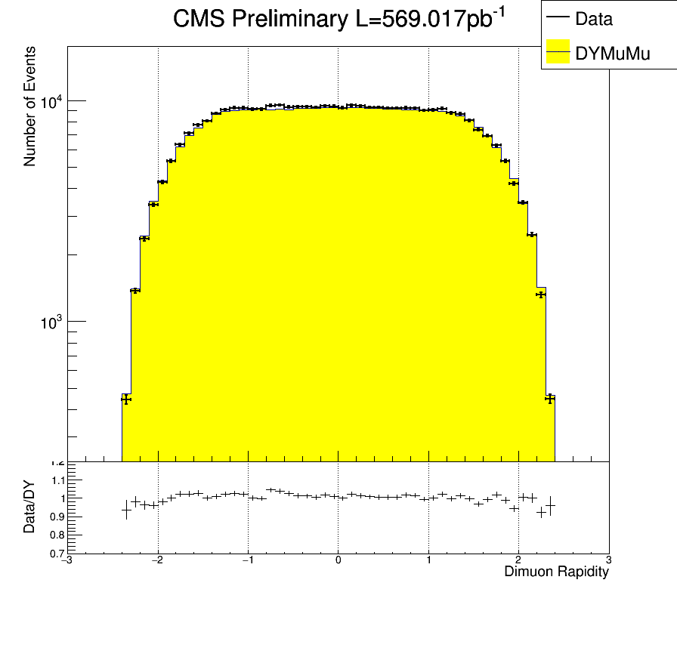
Dimuon Rapidity

Slide 8
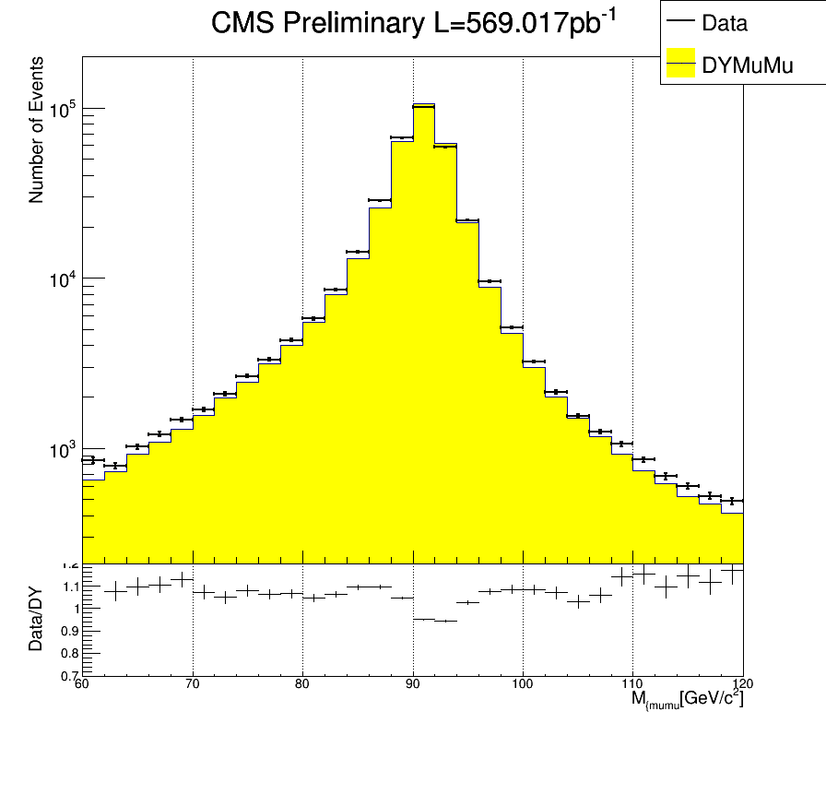
Dimuon Invariant mass

